Slide 1
Data Science Training Linear Modelling
Week 004

Slide 2
Machine Learning
We start moving into Machine Learning.
Cover linear modelling and the basics of training and testing models which will be a springboard into other ML models.
Important ML concepts will be touched on,
Test model accuracy
Cross validation
Stratified Sampling
One hot encoding
See the book on Box or free online An Introduction to Statistical Learning, with Applications in R. Gareth James, Daniela Witten, Trevor Hastie and Robert Tibshirani

Slide 3
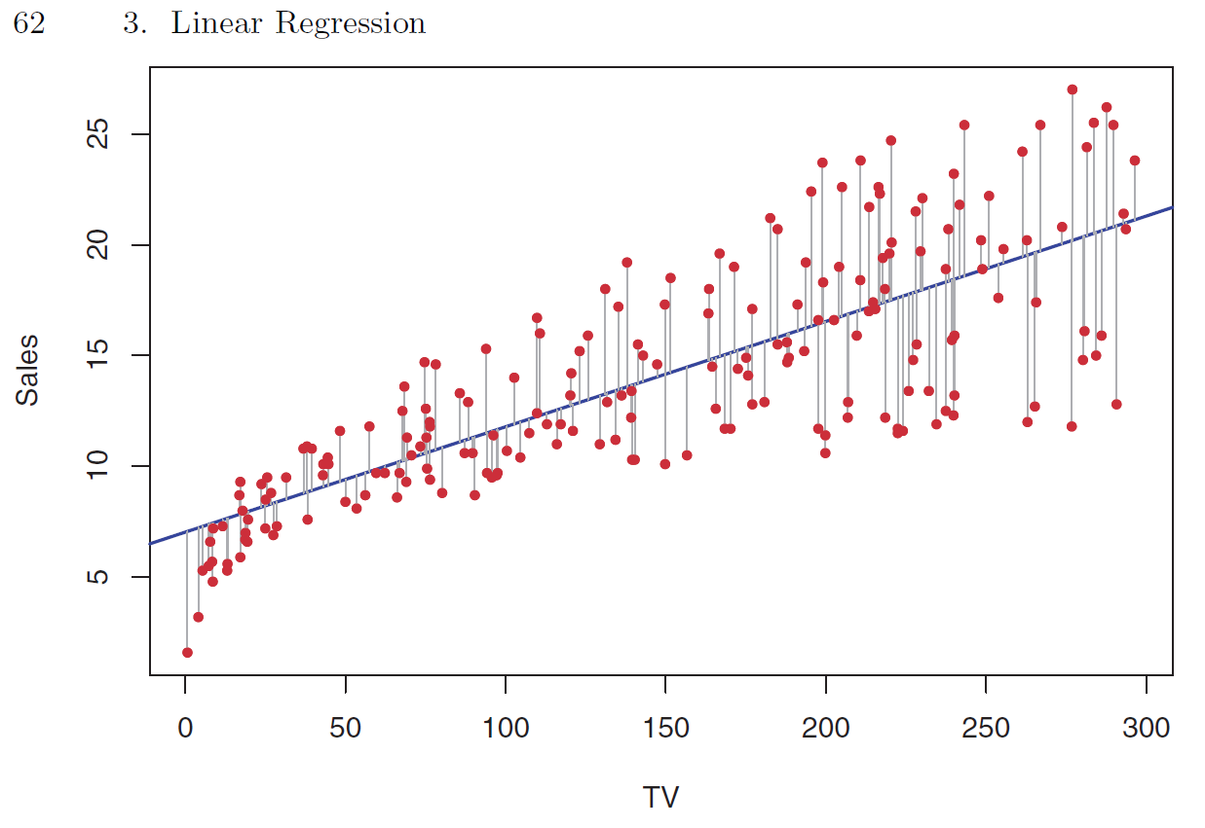
Linear Regression
http://www-bcf.usc.edu/~gareth/ISL/data.html

Slide 4
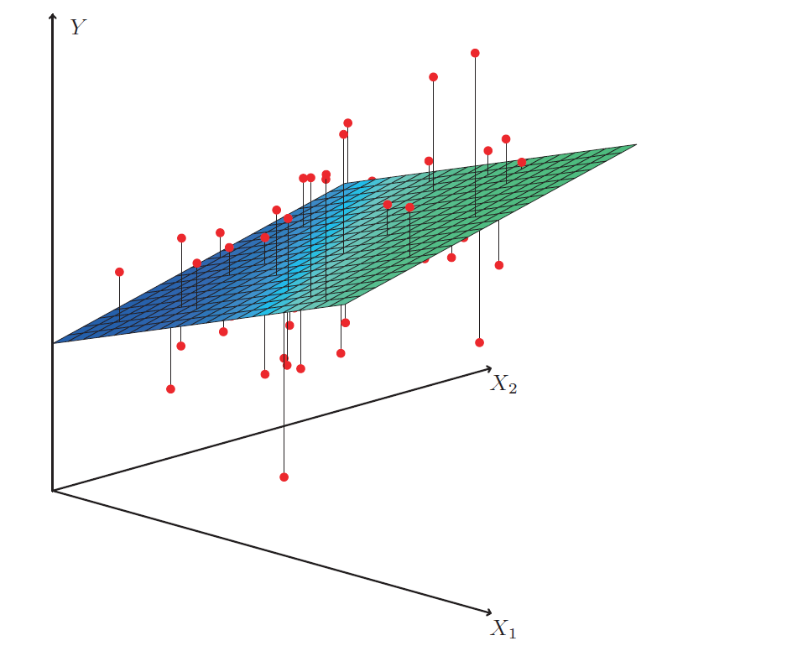
Multiple Linear Regression

Slide 5
Thank you!

